Slide 1
Starting Off
With a partner, take a look at the table below and identify any potential problems with storing your data in a table with this format.
Sales Staff
EmployeeID | SalesPerson | SalesOffice | OfficeNumber | Customers
1003 | Maria Lopez | Chicago | 312-555-1212 | [Ford, GM]
1004 | Andrew Han | New York | 212-444-2323 | [Dell, HP, Apple]
1005 | Laura Moscowitz | New York | 212-444-2323 | [Boeing]

Slide 2
Database Design and Normalization
Reducing redundancy and dependency of data

Slide 3
Today’s Lesson
Aim: SWBAT generate a database schema that has proper constraints and follows the first 3 rules of normalization.
Agenda:
Starting Off
What is DB normalization and why do it?
The 3 normal forms
Design your own DB schema

Slide 4
What is Normalization?
Normalization is a database design technique which organizes tables in a manner that reduces redundancy and dependency of data.
It divides larger tables into smaller tables and links them using relationships.
It can be done on any relational database where data is stored in tables which are linked to each other.
To perform the normalization process you start with a rough idea of the data you want to store and apply certain rules to it in order to get it to a more efficient form.

Slide 5
Why Normalize DBs?
Sales Staff
EmployeeID | SalesPerson | SalesOffice | OfficeNumber | Customers
1003 | Maria Lopez | Chicago | 312-555-1212 | [Ford, GM]
1004 | Andrew Han | New York | 212-444-2323 | [Dell, HP, Apple]
1005 | Laura Moscowitz | New York | 212-444-2323 | [Boeing]
The first thing to notice is this table serves many purposes including:
Identifying the organization’s salespeople
Listing the sales offices and phone numbers
Associating a salesperson with a sales office
Showing each salesperson’s customers
Having the table serve many purposes introduces challenges with data duplication, data update issues, and increased effort to query data.

Slide 6
Data Duplication
Duplicated information presents two problems:
It increases storage requirements and decreases performance.
It becomes more difficult to maintain the database as data changes.
What pieces of data are duplicated in this table?
Sales Staff
EmployeeID | SalesPerson | SalesOffice | OfficeNumber | Customers
1003 | Maria Lopez | Chicago | 312-555-1212 | [Ford, GM]
1004 | Andrew Han | New York | 212-444-2323 | [Dell, HP, Apple]
1005 | Laura Moscowitz | New York | 212-444-2323 | [Boeing]

Slide 7
Modification Anomalies - Insert Anomaly
This company opened a new office in Atlanta, but hasn’t hired any staff there yet.
What issues could arise with adding that office to the table?
Sales Staff
EmployeeID | SalesPerson | SalesOffice | OfficeNumber | Customers
1003 | Maria Lopez | Chicago | 312-555-1212 | [Ford, GM]
1004 | Andrew Han | New York | 212-444-2323 | [Dell, HP, Apple]
1005 | Laura Moscowitz | New York | 212-444-2323 | [Boeing]
??? | ??? | Atlanta | 404-555-1738
Sales Staff
EmployeeID | SalesPerson | SalesOffice | OfficeNumber | Customers
1003 | Maria Lopez | Chicago | 312-555-1212 | [Ford, GM]
1004 | Andrew Han | New York | 212-444-2323 | [Dell, HP, Apple]
1005 | Laura Moscowitz | New York | 212-444-2323 | [Boeing]

Slide 8
Modification Anomalies - Update Anomaly
Let’s say the New York office gets a new phone number. How could updating this cause issue with our data?
Sales Staff
EmployeeID | SalesPerson | SalesOffice | OfficeNumber | Customers
1003 | Maria Lopez | Chicago | 312-555-1212 | [Ford, GM]
1004 | Andrew Han | New York | 212-444-2323 | [Dell, HP, Apple]
1005 | Laura Moscowitz | New York | 212-444-2323 | [Boeing]
Sales Staff
EmployeeID | SalesPerson | SalesOffice | OfficeNumber | Customers
1003 | Maria Lopez | Chicago | 312-555-1212 | [Ford, GM]
1004 | Andrew Han | New York | 212-444-2323 | [Dell, HP, Apple]
1005 | Laura Moscowitz | New York | 212-444-2323 | [Boeing]

Slide 9
Modification Anomalies - Deletion Anomaly
Now imagine that Maria has left the company. What issues with the data can arise from removing her record from the data?
Sales Staff
EmployeeID | SalesPerson | SalesOffice | OfficeNumber | Customers
1003 | Maria Lopez | Chicago | 312-555-1212 | [Ford, GM]
1004 | Andrew Han | New York | 212-444-2323 | [Dell, HP, Apple]
1005 | Laura Moscowitz | New York | 212-444-2323 | [Boeing]
Sales Staff
EmployeeID | SalesPerson | SalesOffice | OfficeNumber | Customers
1003 | Maria Lopez | Chicago | 312-555-1212 | [Ford, GM]
1004 | Andrew Han | New York | 212-444-2323 | [Dell, HP, Apple]
1005 | Laura Moscowitz | New York | 212-444-2323 | [Boeing]

Slide 10
Search and Sort Issues
Sales Staff
EmployeeID | SalesPerson | SalesOffice | OfficeNumber | Customers
1003 | Maria Lopez | Chicago | 312-555-1212 | [Ford, GM]
1004 | Andrew Han | New York | 212-444-2323 | [Dell, HP, Apple]
1005 | Laura Moscowitz | New York | 212-444-2323 | [Boeing]
How would you query this table to find the employee that works with Apple?

Slide 11
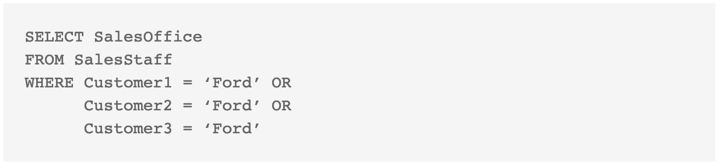
Search and Sort Issues
Sales Staff
EmployeeID | SalesPerson | SalesOffice | OfficeNumber | Customer1 | Customer2 | Customer3
1003 | Maria Lopez | Chicago | 312-555-1212 | Ford | GM | Null
1004 | Andrew Han | New York | 212-444-2323 | Dell | HP | Apple
1005 | Laura Mos... | New York | 212-444-2323 | Boeing | Null | Null

Slide 12
How to Avoid These Issues
WHAT IS DATABASE NORMALIZATION?
Database normalization is the foundation of relational databases. It’s the process that organizes data into tables that can then be connected to each other via the methods described above. Each table should be about a specific topic, and only those columns that support the topic are included in the table.
Database normalization provides the following benefits:
Duplicate data is minimized, and data storage needs decreased.
Changes to data have to occur in only one place.
Access to the data is quicker and more efficient.

Slide 13
First Normal Form Rules (1NF)
Each table cell should contain a single value.
Each record needs to be unique.
Sales Staff
EmployeeID | SalesPerson | SalesOffice | OfficeNumber | Customers
1003 | Maria Lopez | Chicago | 312-555-1212 | [Ford, GM]
1004 | Andrew Han | New York | 212-444-2323 | [Dell, HP, Apple]
1005 | Laura Moscowitz | New York | 212-444-2323 | [Boeing]

Slide 14
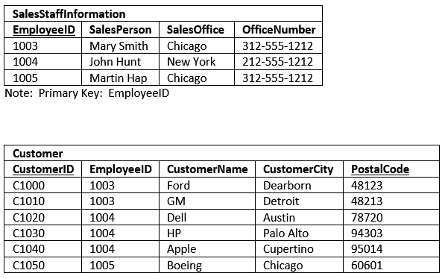
Implementing 1NF
Notes:
This design is superior to our original table in several ways:
The original design limited each SalesStaffInformation entry to three customers. In the new design, the number of customers associated to each design is practically unlimited.
It was nearly impossible to Sort the original data by Customer. You could, if you used the UNION statement, but it would be cumbersome. Now, it is simple to sort customers.
The same holds true for filtering on the customer table. It is much easier to filter on one customer name related column than three.
The insert and deletion anomalies for Customer have been eliminated. You can delete all the customer for a SalesPerson without having to delete the entire SalesStaffInformaiton row.

Slide 15
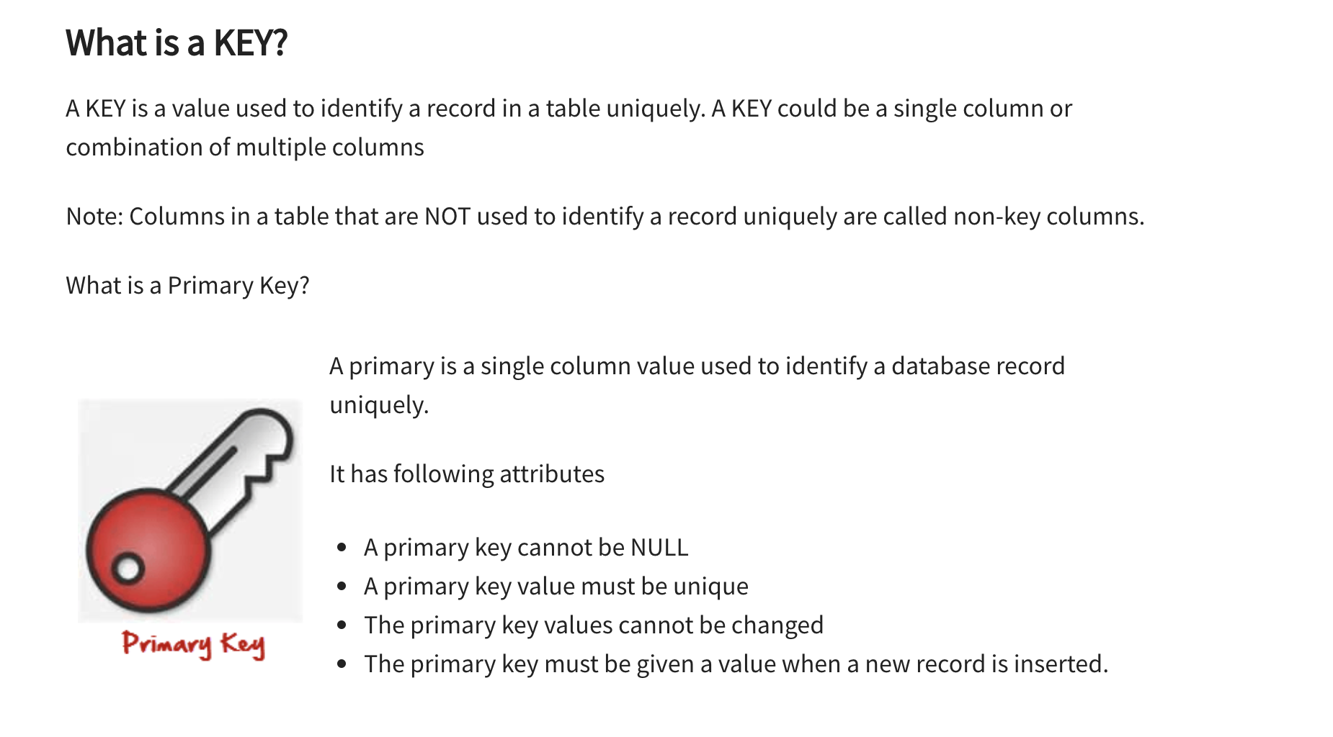
What is a Key

Slide 16
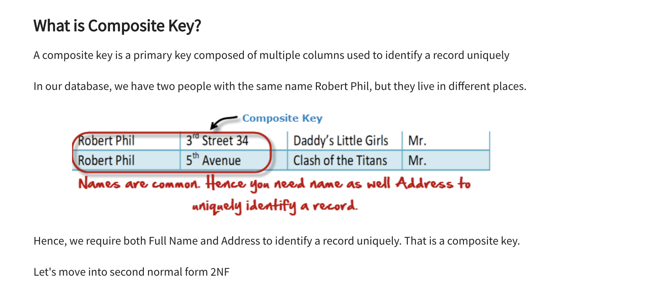
Composite Key

Slide 17
Implementing 1NF
Notes:
This design is superior to our original table in several ways:
The original design limited each SalesStaffInformation entry to three customers. In the new design, the number of customers associated to each design is practically unlimited.
It was nearly impossible to Sort the original data by Customer. You could, if you used the UNION statement, but it would be cumbersome. Now, it is simple to sort customers.
The same holds true for filtering on the customer table. It is much easier to filter on one customer name related column than three.
The insert and deletion anomalies for Customer have been eliminated. You can delete all the customer for a SalesPerson without having to delete the entire SalesStaffInformaiton row.

Slide 18
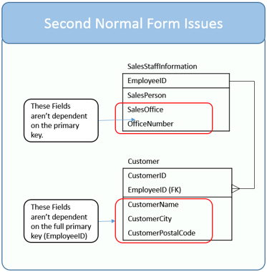
Second Normal Form Rules (2NF)
Table is in 1NF (First normal form)
All the non-key columns are dependent on the table’s primary key
Once you identify a table’s purpose, then look at each of the table’s columns and ask yourself, “Does this column serve to describe what the primary key identifies?”
If you answer “yes,” then the column is dependent on the primary key and belongs in the table.
If you answer “no,” then the column should be moved different table.
Notes:
When all the columns relate to the primary key, they naturally share a common purpose, such as describing an employee. That is why I say that when a table is in second normal form, it has a single purpose, such as storing employee information.

Slide 19
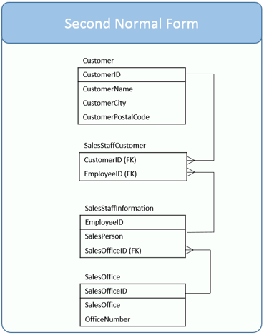
Second Normal Form Rules (2NF)
Table is in 1NF (First normal form)
All the non-key columns are dependent on the table’s primary key
(FK) = Foreign Key
(FK) r in primary keys in another table
Notes:
Once you identify a table’s purpose, then look at each of the table’s columns and ask yourself, “Does this column serve to describe what the primary key identifies?”
If you answer “yes,” then the column is dependent on the primary key and belongs in the table.
If you answer “no,” then the column should be moved different table.
When all the columns relate to the primary key, they naturally share a common purpose, such as describing an employee. That is why I say that when a table is in second normal form, it has a single purpose, such as storing employee information.

Slide 20
Junction Table
The intermediary table is typically referred to as a “junction table” (also as a “cross-reference table”). This table is used to link the other two tables together. It does this by having two fields that reference the primary key of each of the other two tables.
Employee ID | Customer ID
1003 | C1000
1003 | C1010
1004 | C1020
1004 | C1030
1004 | C1040
1005 | C1050

Slide 21
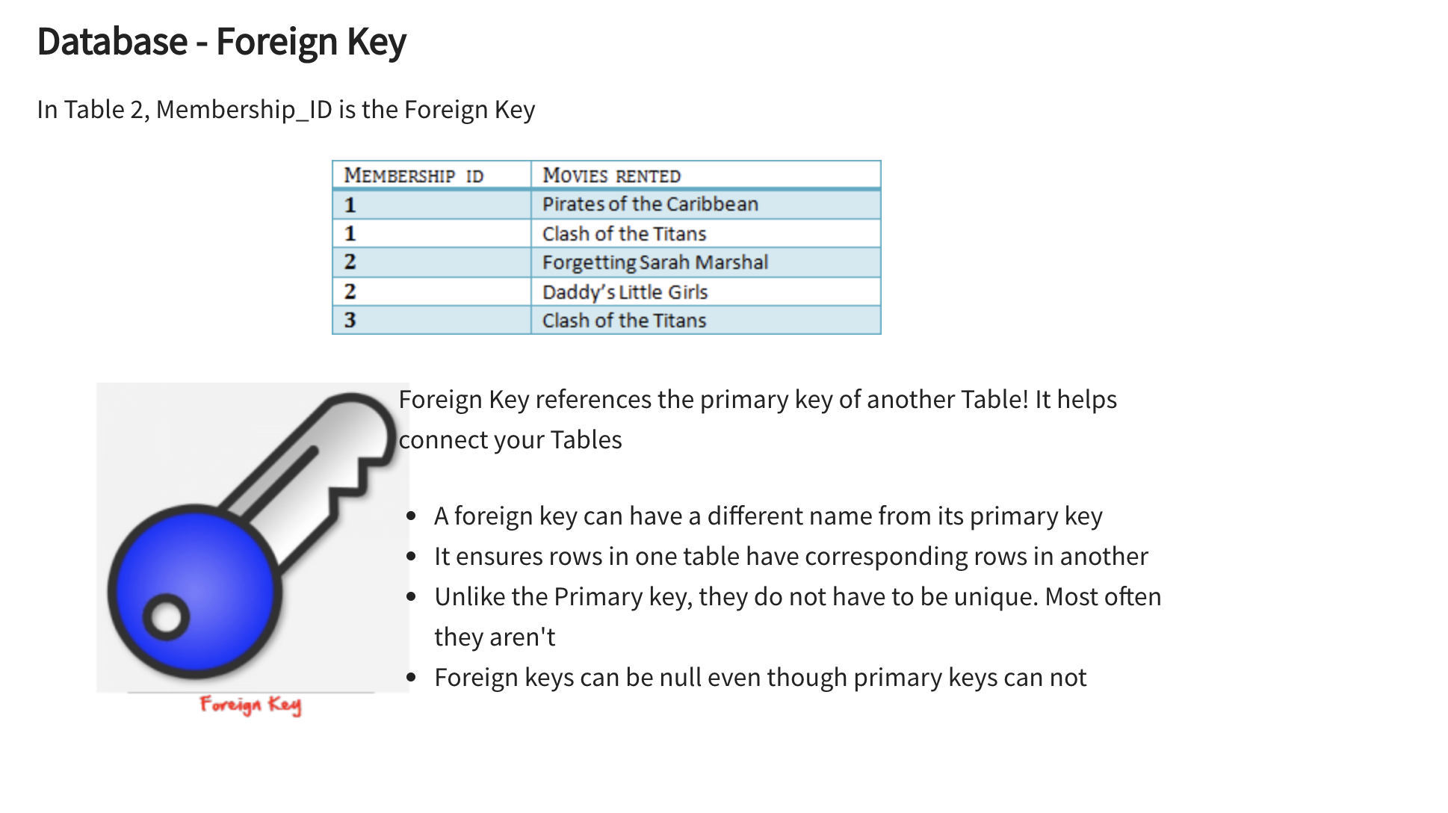
Foreign Key

Slide 22
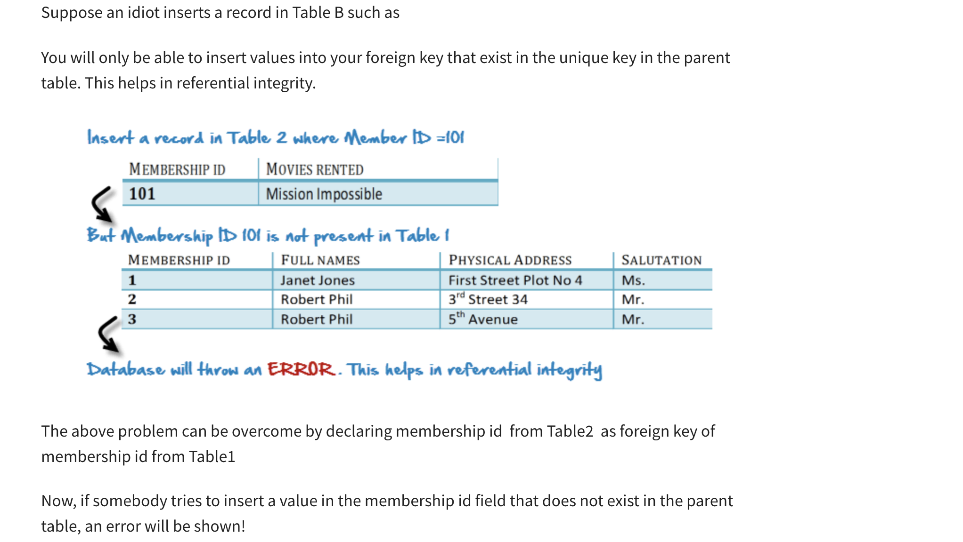
Using a Foreign Key

Slide 23
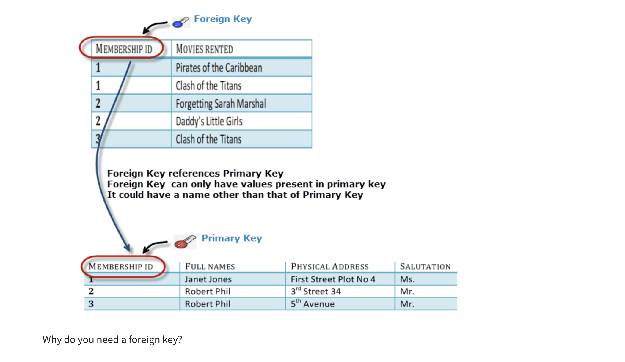
Using a Foreign Key

Slide 24
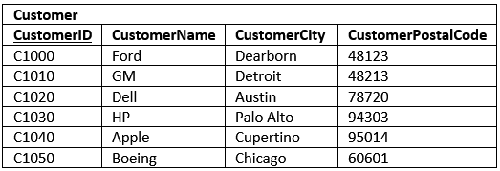
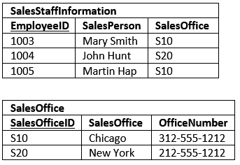
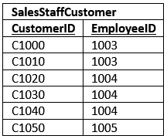
Implementing 2NF
Basically breaking tables into smaller tables and joining the tables with junction tables

Slide 25
Third Normal Form Rules (3NF)
Be in 2NF
Has NO transitive functional dependencies
A transitive functional dependency is when changing a non-key column, might cause any of the other non-key columns to change.
Dependence
An object has a dependence on another object when it relies upon it. In the case of databases, when we say that a column has a dependence on another column, we mean that the value can be derived from the other. For example, my age is dependent on my birthday.
Transitive Dependence
I think it is simplest to think of transitive dependence to mean a column’s value relies upon another column through a second intermediate column

Slide 26
Exploring Transitive Dependence
This can be generalized as being three columns: A, B and PK. If the value of A relies on PK, and B relies on PK, and A also relies on B, then you can say that A relies on PK though B. That is A is transitively dependent on PK.
Primary Key | Column A | Column B | Transitive Dependence
PersonID | FirstName | LastName | No
PersonID | BodyMassIndex | IsOverweight | yes
PersonID | Weight | Sex | no
Vehicle ID | Model | Manufacturer | yes

Slide 27
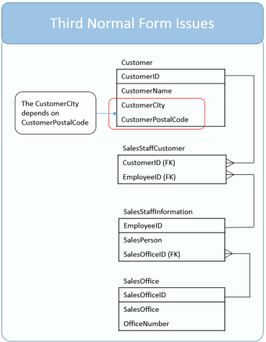
Third Normal Form Rules (3NF)
CustomerCity relies on CustomerPostalCode which relies on CustomerID
Generally speaking a postal code applies to one city. Although all the columns are dependent on the primary key, CustomerID, there is an opportunity for an update anomaly as you could update the CustomerPostalCode without making a corresponding update to the CustomerCity.

Slide 28
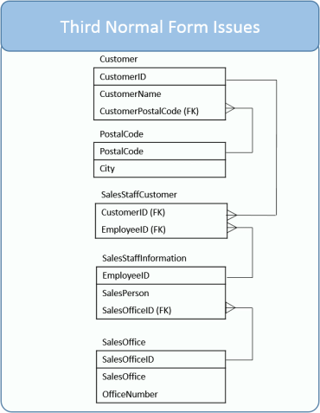
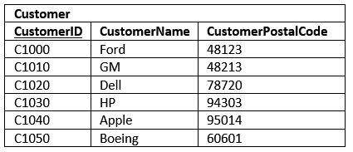
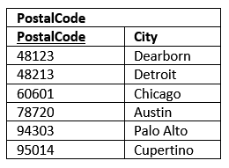
Implementing 3NF

Slide 29
Can Normalization Get out of Hand?
Can database normalization be taken too far? You bet!
There are times when it isn’t worth the time and effort to fully normalize a database. In our example you could argue to keep the database in second normal form, that the CustomerCity to CustomerPostalCode dependency isn’t a deal breaker.

Slide 30
Your Turn - Create DB Schema
Create a DB Schema
Follow the 3NF
Include at least 3 tables
Have at least 1 Junction table
Index | Song | Length | Album | Year | Label | Artist
15673 | F.U.B.U. | 5:13 | A Seat at the Table | 2016 | Columbia | Solange
19834 | Don’t Touch My Hair | 4:17 | A Seat at the Table | 2016 | Columbia | Solange
16745 | Things I Imagined | 1:59 | When I get Home | 2019 | Columbia | Solange
20923 | I’m a Witness | 1:52 | When I get Home | 2019 | Columbia | Solange
21723 | Treat Me Like Your Mother | 4:10 | Horehound | 2009 | Warner | The Dead Weather
22634 | 3 Birds | 3:44 | Horehound | 2009 | Warner | The Dead Weather

Slide 31
References
https://www.essentialsql.com/get-ready-to-learn-sql-database-normalization-explained-in-simple-english/
https://www.guru99.com/database-normalization.html
https://beginnersbook.com/2015/04/constraints-in-dbms/

